Slide 1
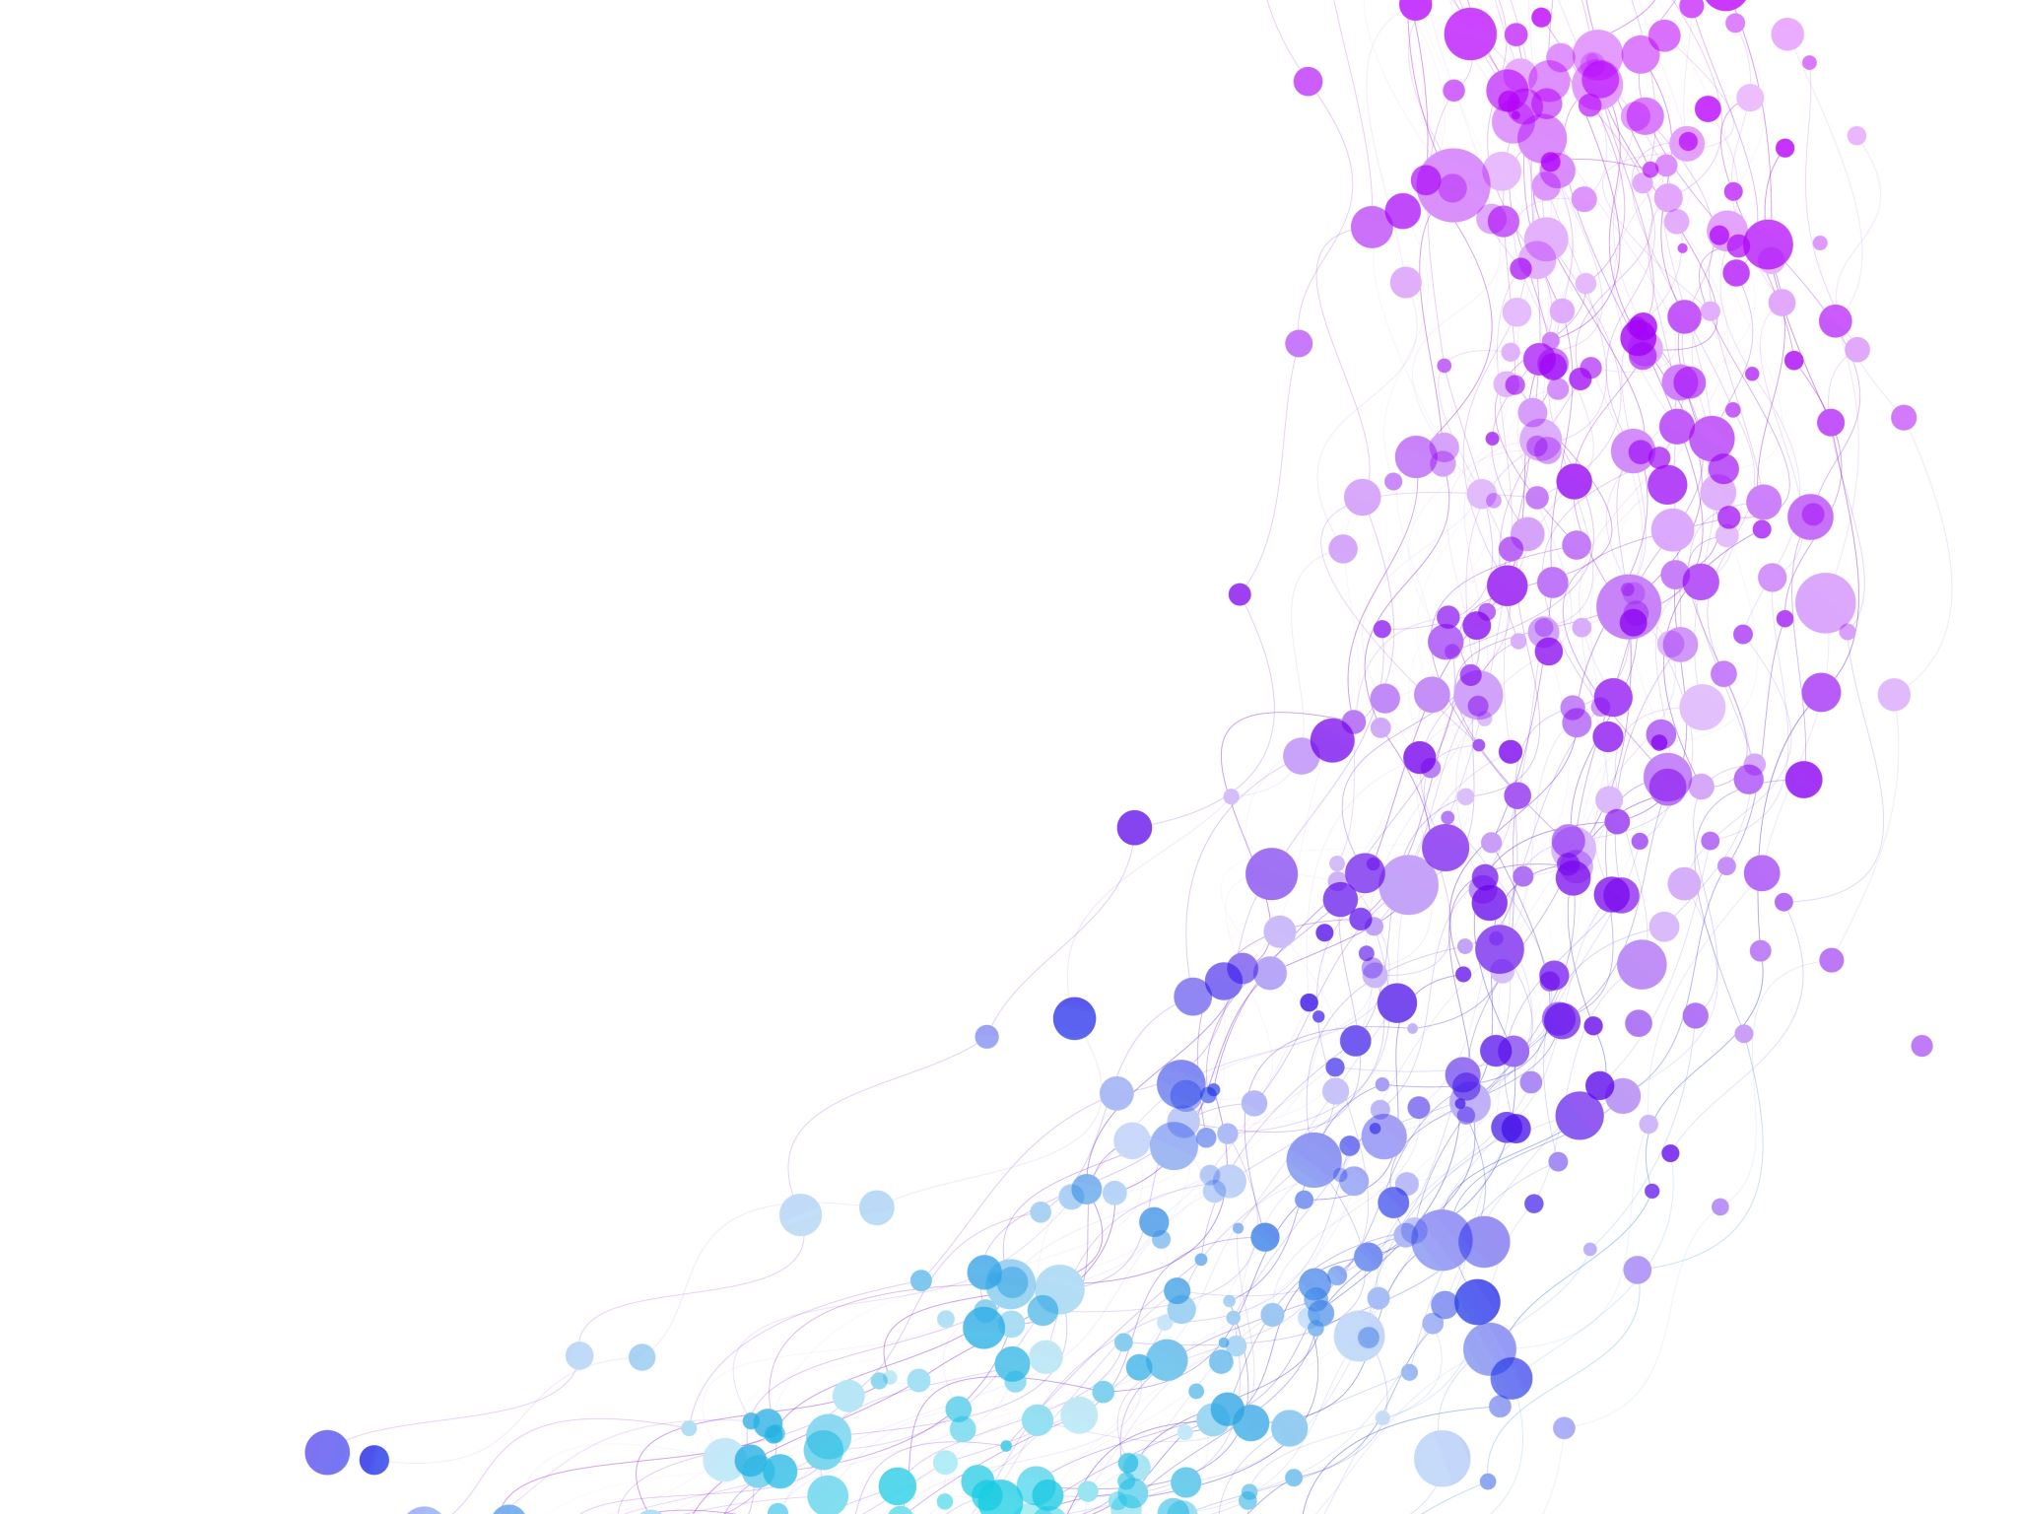


Data Models, Schema and Instance Session No.: 4 Course Name: Database Management System Course Code: E2UC302B Instructor Name: Dr. Sandeep Kumar M
Galgotias University Students-Centred Active Learning Ecosystem

Slide 2

Pre-Assessment

Slide 3
Recap
Database System Concept: A database is a structured collection of data managed by a Database Management System (DBMS) that allows efficient storage, retrieval, and manipulation of data.
Three-Level Architecture
External Level – user view of the data.
Conceptual Level – community view, logical structure of the database.
Internal Level – physical storage of data.
Data Independence: The architecture supports logical independence (changes in conceptual schema don’t affect user views) and physical independence (changes in storage don’t affect logical schema).
DBMS Components: Includes storage manager, query processor, and transaction manager, which ensure data consistency, security, integrity, and concurrent access.

Slide 4
At the end of this session students will be able to :
LO1: Explain the Concept of a Data Models.
LO2: Illustrate and apply database Schema and Instance in Model.
Galgotias University Students-Centred Active Learning Ecosystem
03.03.2025

Slide 5
Session Outline
1. What is DBMS.
2. Data Models and its types.
3. Activity 1: Think Pair Share
4.Difference Between Schema and Instance.
5. Activity 2-Case Study based discussion.
6.Conclusion

Slide 6
Opening Question
"If you were asked to design a database for a hospital system, how would you represent the structure of data (patients, doctors, treatments, etc.) and how would the actual stored values look?"

Slide 7
Opening Question-Reflection
Structure Representation:
Use entities like Patients, Doctors, Appointments, Treatments, and Billing.
Define relationships (e.g., a patient can have many appointments; a doctor can treat many patients).
Create an ER Diagram to model attributes (e.g., Patient_ID, Name, Age, Diagnosis).
Stored Values Representation:
In tables, each row holds actual data (e.g., a patient record: P001, “Rahul Sharma”, 45, “Diabetes”).
Foreign keys link records (e.g., Appointment table links Patient_ID and Doctor_ID).
Data is stored in relational tables for easy retrieval, updates, and reporting.

Slide 8
Introduction on DBMS
In a Database Management System (DBMS), data must be organized, structured, and represented properly for effective storage, retrieval, and manipulation.
Three fundamental concepts form the basis of database organization:
Data Models
Schemas
Instances

Slide 9
Data Model
Definition
A data model is a set of concepts and rules used to describe the structure of a database, the relationships between data, and the constraints on the data.
Purpose of Data Models:
Provide abstraction of data.
Help database designers represent data logically.
Serve as a bridge between real-world entities and database design.

Slide 10
Types of Data Models
High-Level (Conceptual Data Models)
Provide a user-friendly view of data.
Example: Entity-Relationship (ER) Model.
Used in early stages of design.
Representational (Implementation Data Models)
Hide some storage details but show how data is organized.
Example: Relational Model (tables, attributes, tuples).
Used for logical design.

Slide 11
Cont..
Low-Level (Physical Data Models)
Describe how data is stored in computer systems (files, indexes).
Example: Hashing, B-trees, and storage blocks.

Slide 12
Schema
Definition
A schema is the overall logical structure (blueprint) of the database .It defines how the data is organized and the relationships among data.
Key Points:
Schema is the design or plan of the database.
It is specified during database design and rarely changes.
Acts as a blueprint, just like the structure of a building.
Types of Schemas:
Physical Schema: Defines how data is stored on disk (storage details).
Logical Schema: Describes tables, attributes, constraints, and relationships.
View Schema (External Schema): Describes user views, tailored for different applications.

Slide 13
Cont.
Example (Student Database Schema):
Student(RollNo, Name, Program, YearOfAdmission)
Course(CourseCode, CourseName, Credits)
Faculty(FacultyID, Name, Department)
Enrollment(RollNo, CourseCode, Grade)

Slide 14
Instance
Definition
An instance is the snapshot of data in the database at a particular point in time.
Key Points
Represents the actual data stored in the database.
Instances change frequently (inserts, updates, deletions).
Schema remains stable, while instances are dynamic.
.

Slide 15
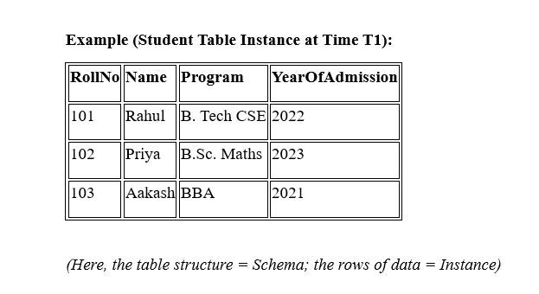
Cont.

Slide 16
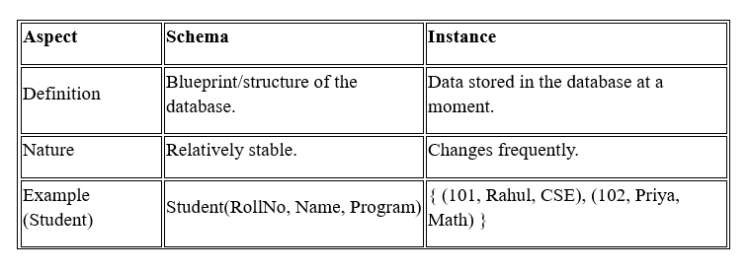
Schema vs Instance

Slide 17
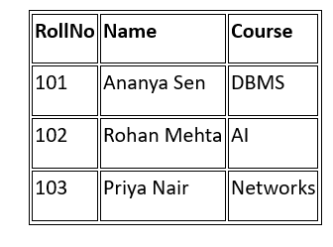
Activity 1: Think Pair Share
Database Example (Student Database):
Schema (Structure/Blueprint): Student(RollNo, Name, Course)
Instances (Actual Data/Values):
Think – Look at the schema and data table. Which part represents the schema? Which part represents instances?
Pair – Discuss with your partner and justify your answer.
Share – Present your reasoning with the class.

Slide 18
Activity 1: Think Pair Share- Reflection
Expected Reflection:
The schema is the fixed structure (attributes RollNo, Name, Course).
The instances are the rows of data (records of individual students).

Slide 19
Activity 2: Case Study based Discussion
A university wants to maintain a database system to manage information about students, courses, and faculty. The following requirements are identified:
Each Student has a RollNo, Name, Program, and Year of Admission.
Each Course has a CourseCode, CourseName, and Credits.
Each Faculty Member has a FacultyID, Name, and Department.
A student can enroll in many courses, and each course can be taught by one faculty member.
Questions
1. Data Model:
Identify which data model (Hierarchical, Network, Relational, etc.) is most appropriate for this scenario and justify your choice.
2. Schema:
Write down the schema definitions for Student, Course, Faculty, and Enrollment tables.
(Example: Student(RollNo, Name, Program, YearOfAdmission))

Slide 20
Cont..
Questions
3. Instance:
Provide an example instance of the Student and Course tables with at least 3 records each.

Slide 21
Activity 2: Reflection on Case Study based Discussion
1. Data Model
The most appropriate data model is the Relational Model.
Justification: It represents data in tables with rows and columns, supports relationships (one-to-many, many-to-many), and is widely used in universities for managing students, courses, and faculty efficiently.
2. Schema Definitions
Student(RollNo, Name, Program, YearOfAdmission)
Course(CourseCode, CourseName, Credits)
Faculty(FacultyID, Name, Department)
Enrollment(RollNo, CourseCode, FacultyID)

Slide 22
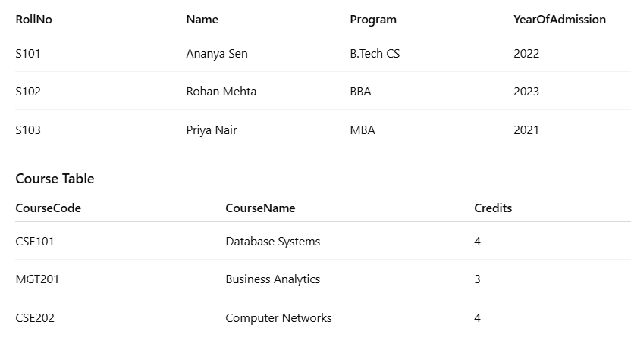
Cont..
3. Instances (Example Data)
Student Table

Slide 23
Post-Assessment

Slide 24
Review and Reflection

Slide 25
Thank you

